Slide 1
Skin Lesion Segmentation and classification using U-Net and ResNet
Under Guidence Of : Presented By :
Dr BH Shekar Name :Bhawya devi
Reg No : P05AZ23S038006

Slide 2
Introduction
Skin cancer is one of the most common and life-threatening diseases worldwide, making early detection crucial for effective treatment.
Traditional diagnostic methods rely on manual examination by dermatologists, which can be time-consuming and prone to subjectivity.
To address this, automated skin lesion segmentation and classification using deep learning has emerged as a powerful approach.
In this project, we use U-Net for accurate skin lesion segmentation and ResNet for reliable classification of different lesion types.

Slide 3
Objectives
To preprocess dermoscopic images for enhancing lesion visibility and reducing artifacts.
To develop a segmentation model (U-Net) for precise identification of lesion boundaries.
To implement a classification model (ResNet) for categorizing skin lesions into different types.
To handle class imbalance and improve prediction accuracy using appropriate techniques.
To integrate the trained models into a user-friendly web application (DermaCare) for practical usage.

Slide 4
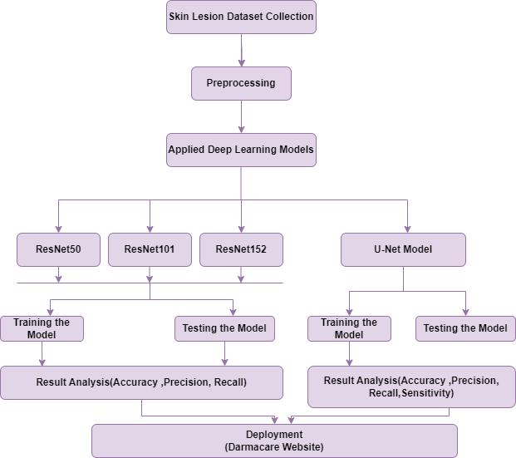
Architecture Of Proposed System

Slide 5
Dataset Used
This project uses dermoscopic images from the ISIC 2018 and ISIC 2019 challenges.
The ISIC 2018 dataset (3,693 images) includes segmentation masks for training and evaluating lesion boundary detection.
The ISIC 2019 dataset (25,331 images) is used for multiclass classification across eight lesion types, such as melanoma, nevus, and basal cell carcinoma.
While the datasets offer diverse lesion types and imaging conditions, they suffer from class imbalance, which is addressed using techniques like oversampling and class weighting.

Slide 6
Methodology
Preprocessing
Preprocessing plays a key role in improving the accuracy of skin lesion segmentation and classification. Various techniques used are :
Resizing All images are resized to 224×224 pixels to match the CNN input size. This ensures dataset uniformity and reduces computational complexity while preserving image quality.
Normalization Pixel values are scaled from [0, 255] to [0, 1], which stabilizes training, prevents gradient issues, and allows faster model convergence.
Enhancement (CLAHE) CLAHE improves lesion visibility by enhancing local contrast while avoiding noise amplification, making subtle structures clearer for classification.

Slide 7
Hair Removal Hair artifacts are removed using edge detection and inpainting, producing cleaner images so the model focuses on lesion features instead of obstructions.
Augmentation Data augmentation increases dataset diversity and helps the model generalize better. Techniques such as rotation, flipping, zoom, and brightness adjustment simulate real-world variations in orientation, scale, and lighting. This not only enlarges the training set but also reduces overfitting by preventing the model from memorizing specific image patterns.

Slide 8
Models Used
Different models used in this project are:
For Segmentation:
U-Net
For Classification:
ResNet-50
ResNet-101
ResNet-152

Slide 9
U-Net
U-Net is a deep learning model designed for biomedical image segmentation. It follows a U-shaped architecture consisting of two main parts:
Contracting Path (Encoder) – Extracts important features using convolutional layers and downsampling through max pooling, reducing spatial dimensions while capturing context.
Expanding Path (Decoder) – Uses transposed convolutions (upsampling) to restore the spatial resolution and refine segmentation.
Skip Connections – Directly connect encoder and decoder layers to retain fine details and improve segmentation accuracy.
U-Net is widely used in medical imaging due to its ability to generate precise segmentations even with limited training data.

Slide 10
ResNet
Residual Network (ResNet), introduced in 2015, is a popular deep learning model for image classification. It uses residual learning with shortcut connections to solve the vanishing gradient problem, enabling the training of very deep networks for capturing complex features.
The structure of the ResNet model can be summarized as follows:
Convolutional Layers: The input image passes through multiple convolutional layers, each followed by batch normalization and a ReLU activation function. These layers extract low- and high-level features, with downsampling performed via max pooling.

Slide 11
Shortcut Connections: Residual (shortcut) connections skip one or more layers, allowing the network to learn identity mappings. This design addresses the vanishing gradient problem and enables deeper architectures.
Output Layer: A global average pooling layer reduces the spatial dimensions, followed by a fully connected layer with softmax activation to output class probabilities. The predicted class is the one with the highest probability.
Different ResNet models used are listed below.

Slide 12
ResNet-50
50-layer deep convolutional network.
Organized into 16 residual blocks.
Uses bottleneck layers to reduce computation.
Good balance of speed and accuracy.
ResNet-101
101-layer deep network for deeper feature extraction.
Contains 33 residual blocks.
Captures more complex patterns than ResNet-50.
Requires higher computation.
ResNet-152
152-layer very deep convolutional network.
Contains 50 residual blocks.
Achieves very high accuracy for large-scale tasks.
More training time and memory usage.

Slide 13
Performance Matrix
Several performance metrics were used to evaluate the effectiveness of the classification model on dermoscopic skin lesion images.
Accuracy:
Measures the proportion of correctly classified images out of the total images.
Precision, Recall, and F1-Score (per class):
Precision indicates how many of the images predicted as a certain class actually belong to that class.
Recall (Sensitivity) measures how many of the true images of a class were correctly identified.
F1-Score is the harmonic mean of precision and recall, providing a balanced measure of the model’s performance for each class.
These metrics are particularly important in medical imaging, where false negatives (missing a melanoma, for example) are more critical than false positives.
Confusion Matrix:
A visual representation showing the number of correct and incorrect predictions for each class.

Slide 14
Web Application Implementation
DermaCare Website: An interactive platform where users can upload dermoscopic images and receive automated predictions from the trained models.
Technologies Used :
Frontend (ReactJS): Responsive UI for image upload, prediction display, and navigation.
Backend (Flask/FastAPI): Handles API requests, loads trained models (ResNet101 for classification, U-Net for segmentation).
Preprocessing: Uploaded images resized and normalized to meet model input requirements.
Visualization: Segmentation masks and classification results shown on the UI for easy interpretation.

Slide 15
Results
U-Net Model Performance Table
U-Net achieved 90.1% global accuracy, showing strong overall segmentation ability.
Metric | Value
Sensitivity (Recall) | 0.8983
Specificity | 0.9754
Precision | 0.8025
F1 Score | 0.8178
Global Accuracy | 0.9010

Slide 16
ResNet50 Performance Table
ResNet-50 achieved moderate performance with 50% accuracy.
Best results seen in NV (Nevus) class with F1 = 0.75.
Poor generalization for minority classes like SCC, AK, and VASC.
Class | Precision | Recall | F1-Score | Support
MEL | 0.42 | 0.40 | 0.41 | 362
NV | 0.83 | 0.68 | 0.75 | 1030
BCC | 0.53 | 0.38 | 0.45 | 266
AK | 0.52 | 0.16 | 0.24 | 70
BKL | 0.41 | 0.34 | 0.37 | 210
DF | 0.55 | 0.32 | 0.40 | 19
VASC | 0.83 | 0.25 | 0.38 | 20
SCC | 0.29 | 0.10 | 0.15 | 50
Accuracy | - | - | 50% | -

Slide 17
ResNet101 Performance Table
Class | Precision | Recall | F1-Score | Support
MEL | 0.70 | 0.66 | 0.68 | 664
NV | 0.88 | 0.89 | 0.89 | 1974
BCC | 0.75 | 0.86 | 0.80 | 501
AK | 0.62 | 0.61 | 0.62 | 121
BKL | 0.70 | 0.65 | 0.68 | 381
DF | 0.77 | 0.71 | 0.74 | 38
VASC | 0.81 | 0.81 | 0.81 | 37
SCC | 0.68 | 0.62 | 0.65 | 84
Accuracy | - | - | 80% | 3800
ResNet-101 performed significantly better with 80% accuracy.
Strong results across majority and minority classes.
NV and BCC classes show the highest F1-scores (>0.80).

Slide 18
ResNet152 Performance Table
Class | Precision | Recall | F1-Score | Support
MEL | 0.62 | 0.68 | 0.65 | 664
NV | 0.91 | 0.82 | 0.86 | 1974
BCC | 0.74 | 0.83 | 0.78 | 501
AK | 0.60 | 0.62 | 0.61 | 121
BKL | 0.62 | 0.69 | 0.65 | 381
DF | 0.69 | 0.76 | 0.72 | 38
VASC | 0.79 | 0.84 | 0.82 | 37
SCC | 0.59 | 0.63 | 0.61 | 84
Accuracy | - | - | 75% | 3800
ResNet-152 achieved 75% accuracy, slightly lower than ResNet-101.
Balanced performance across classes, especially VASC and DF.
MEL class improved recall (0.68) compared to ResNet-50.

Slide 19
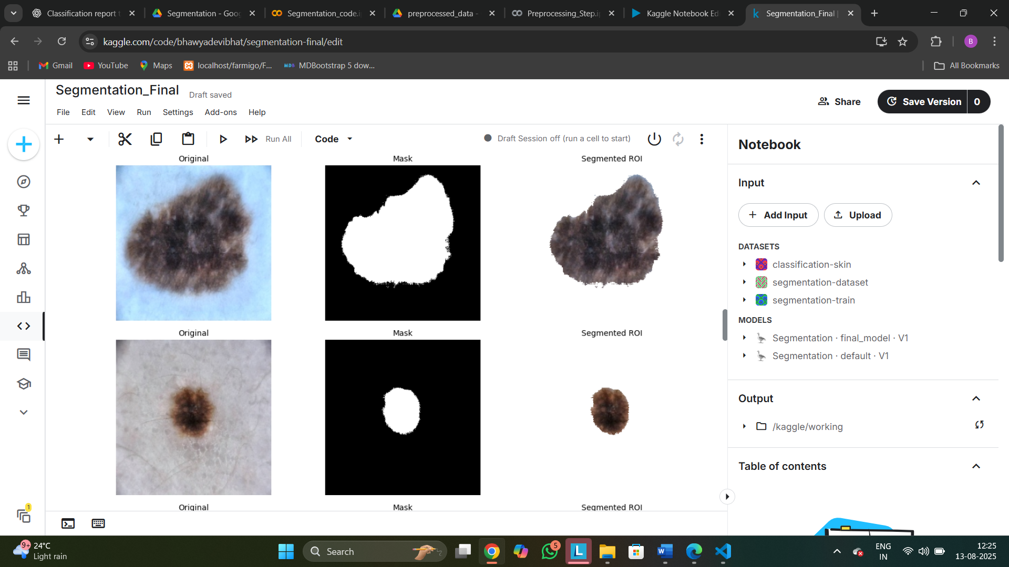
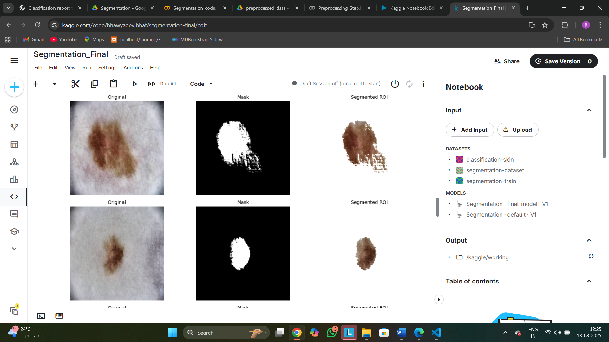
Sample Result images Segmentation output of Unet model

Slide 20
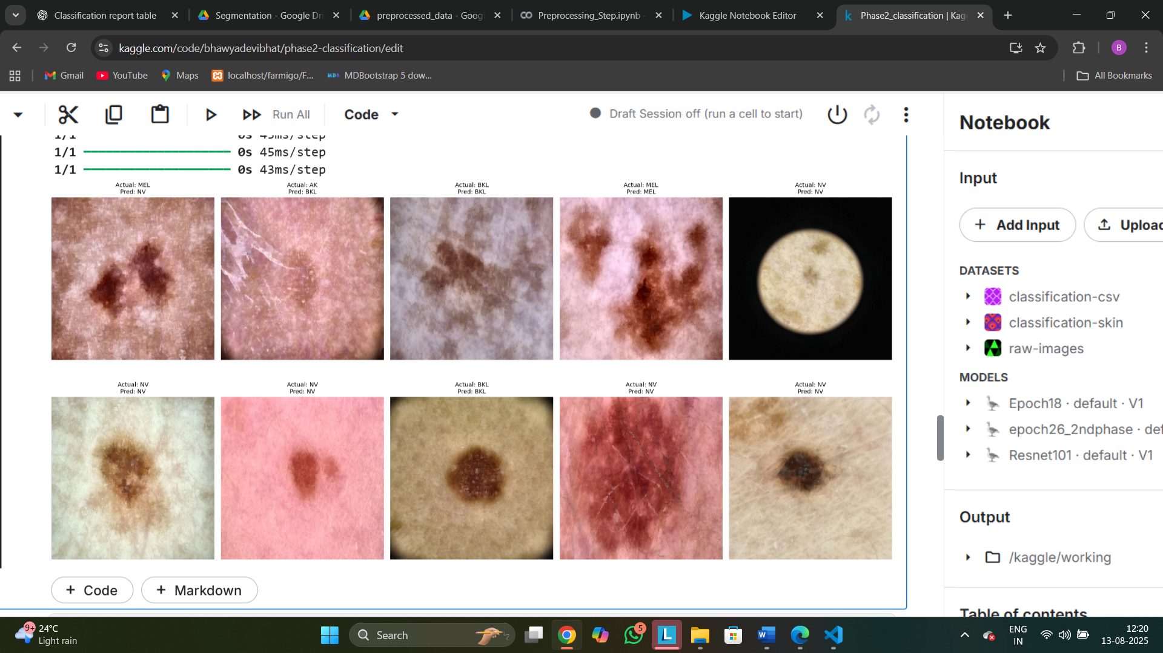
Output of ResNet 101 model

Slide 21
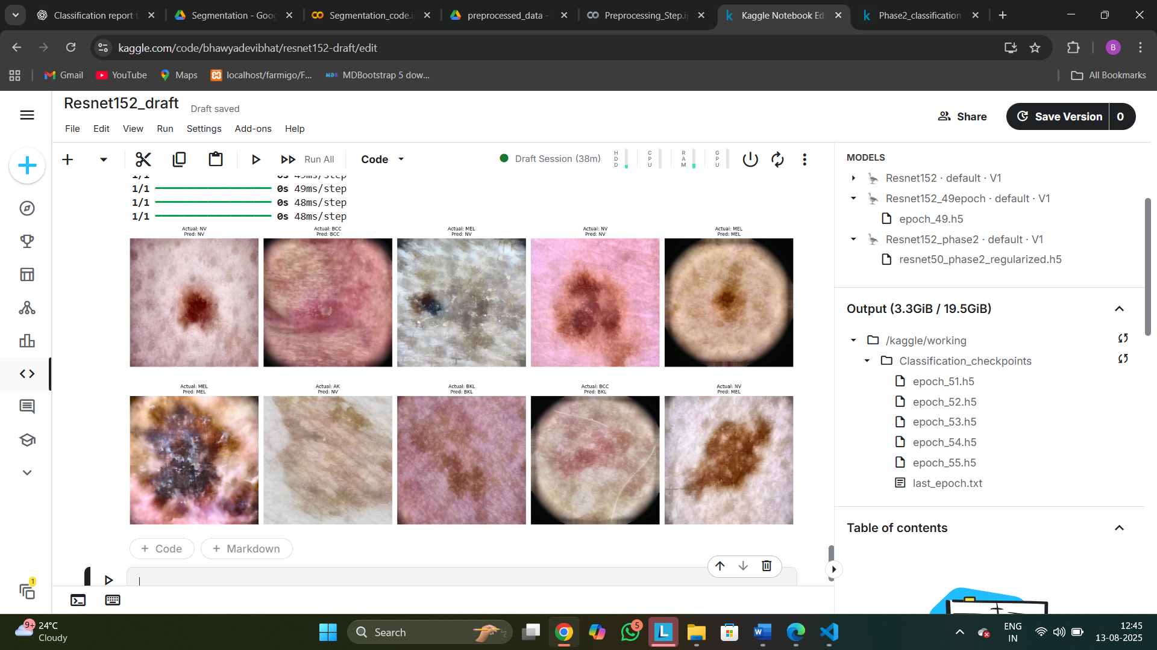
Output of ResNet 152 model

Slide 22
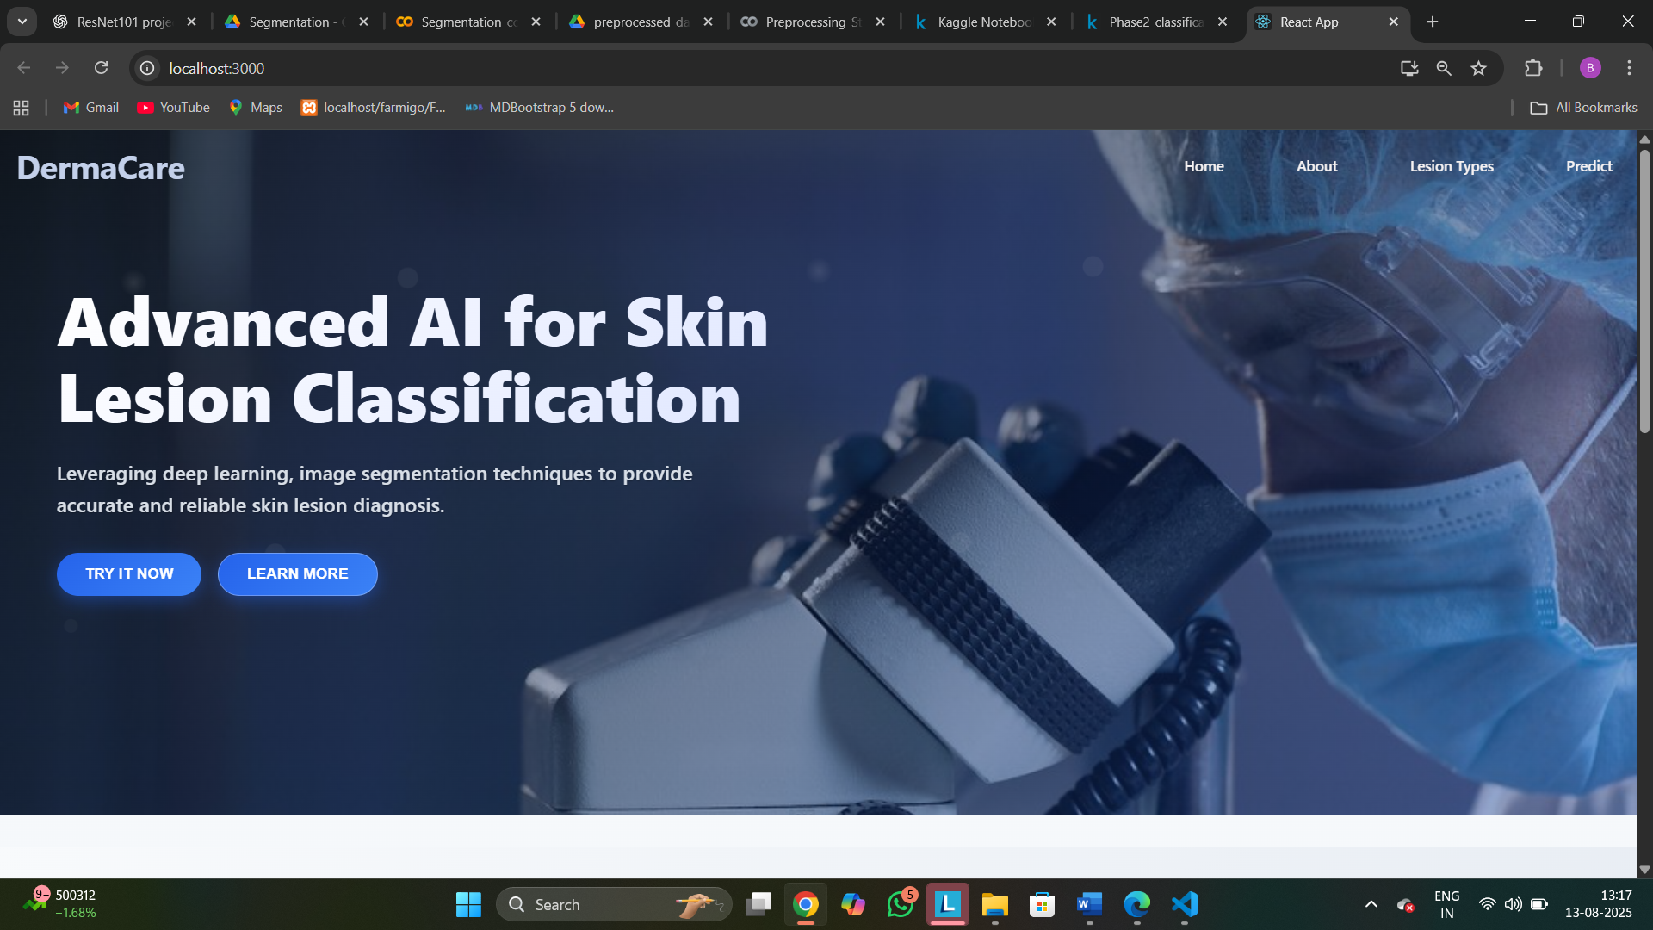
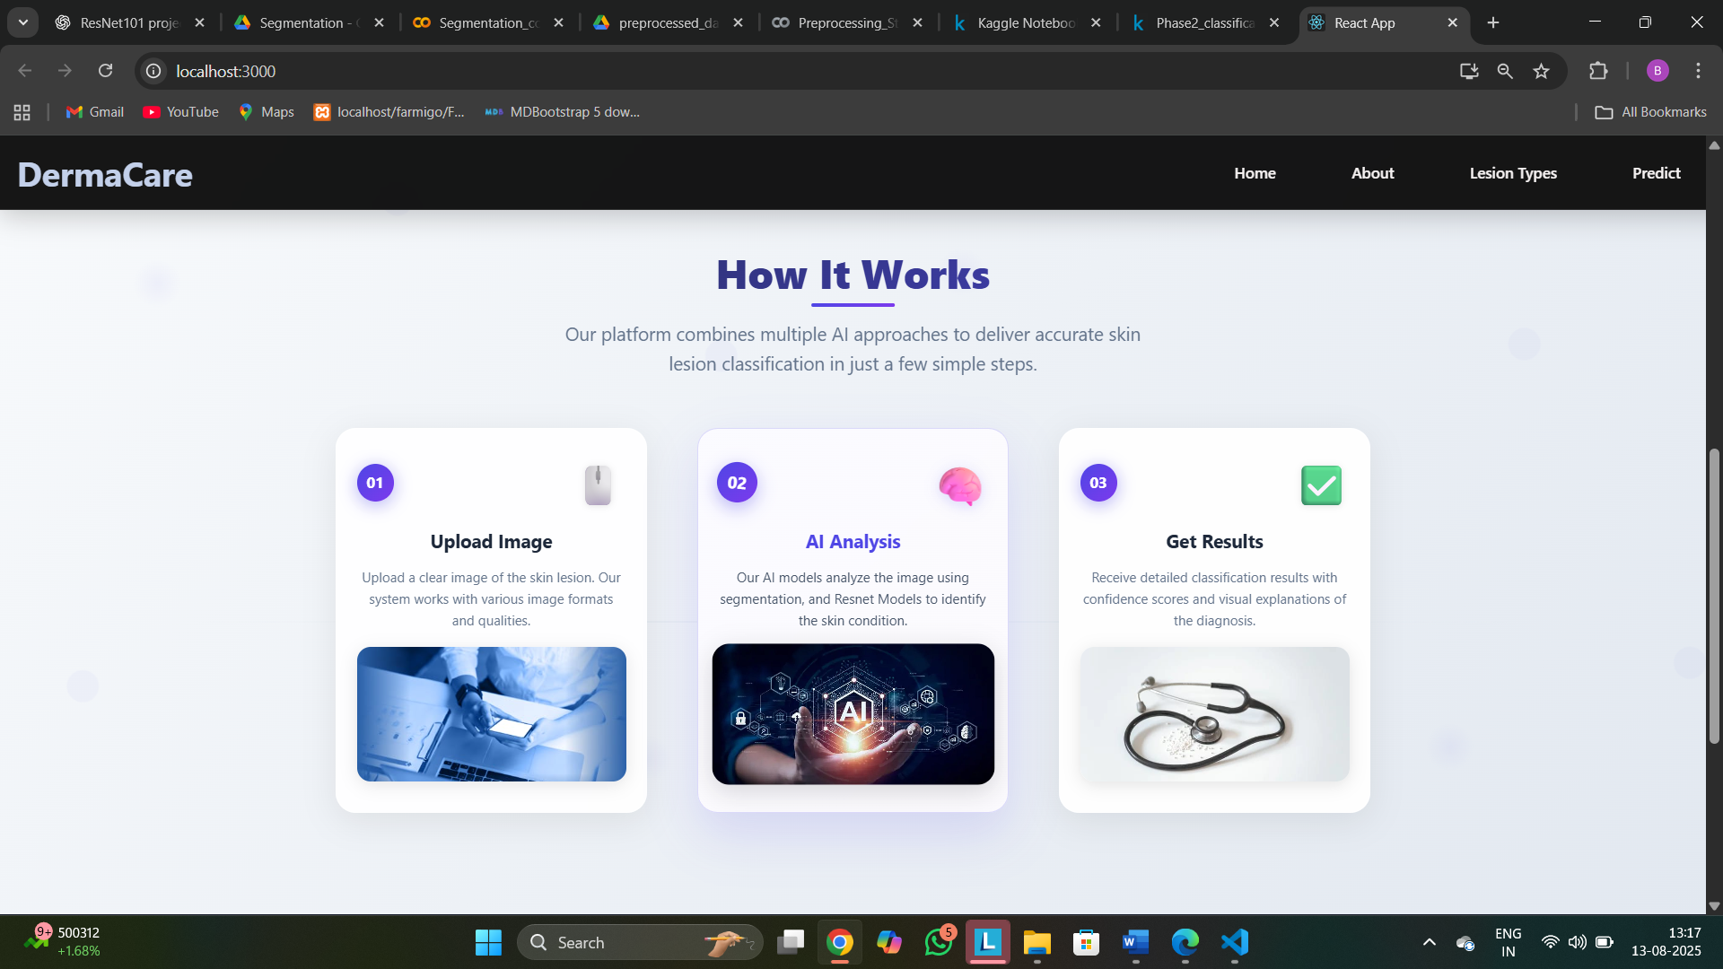
User Interface
Home Page: Introduces the application and its purpose, offering easy navigation to other sections.

Slide 23
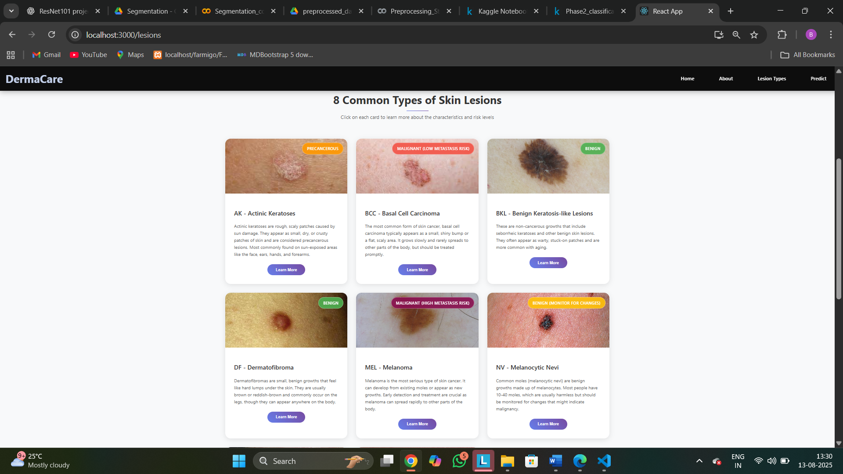
Lesion Types page :

Slide 24
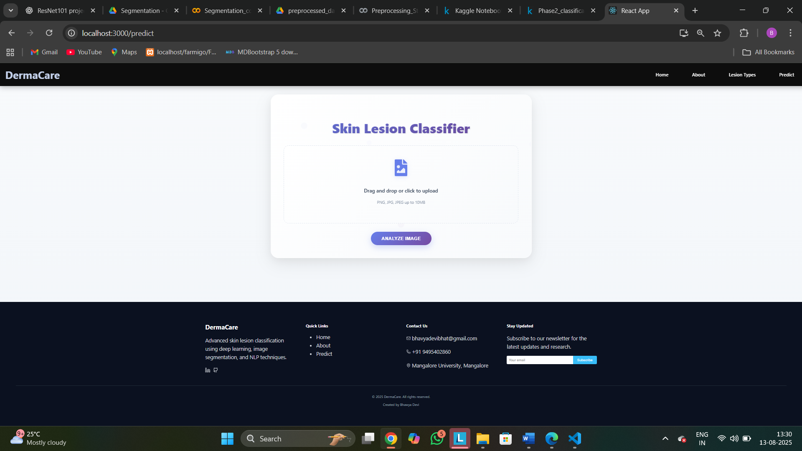
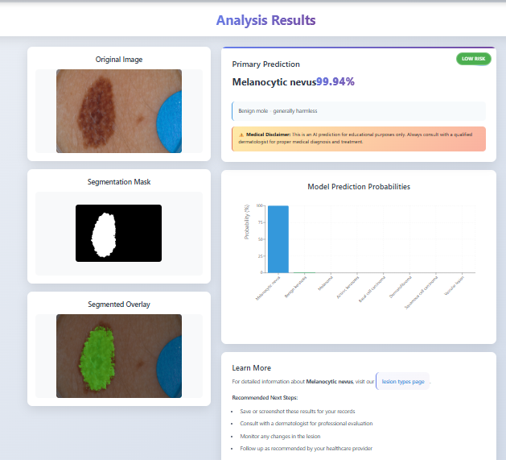
Predict Page :

Slide 25
Challenges/Limitations
Visual Similarity Between Lesions
Many skin lesions share similar characteristics in terms of color, shape, and texture.
This overlap makes it challenging for models to distinguish correctly, often leading to misclassification.
Class Imbalance in Dataset
ISIC datasets are highly imbalanced in class distribution.
Models tend to favor majority classes, resulting in poor performance for minority categories.
Challenges in Lesion Segmentation Due to Irregular Shapes
Skin lesions rarely have well-defined or regular boundaries.
Their irregular, fuzzy contours make segmentation difficult with traditional methods.
Hence, advanced deep learning approaches (e.g., U-Net) are required to handle this complexity.
High Computational Requirements
Deep models such as U-Net and ResNet demand powerful GPUs, large memory, and longer training time.
Researchers or institutions with limited resources may find it hard to train and fine-tune these models effectively.

Slide 26
Conclusion
Three ResNet variants (ResNet50, ResNet101, ResNet152) were applied for skin lesion classification on the ISIC 2019 dataset.
ResNet50, with fewer layers, achieved a lower accuracy of 50%, showing limitations in learning complex features.
ResNet101 outperformed the others with 80% accuracy, demonstrating the best balance between depth and generalization.
ResNet152, despite being deeper, achieved 75% accuracy, suggesting that excessive depth may lead to overfitting or reduced efficiency.
Overall, ResNet101 proved to be the most effective model for this task.
In summary, this project helps in automating skin lesion detection, making it faster, more accessible, and more reliable. Future improvements, like using better models or advanced techniques, can further increase accuracy and performance.

Slide 27
THANK YOU

